Slide 1

Wednesday, October 24, 2012
TISK Problems
Simplify: $3x−9y−\left(4x+7y\right)$
Simplify: $−5(3x−8)$
Find the 6th term in this sequence:
6, -8, 7, -9, …
There will be 2 Mental Math questions today.
Homework: Permutations & Factorials practice worksheet
Notes:
Mental Math
1.) Multiply 8 and 7. Double it. Triple it. (336)
2.) Multiply 4 and 3. Double it. Multiply by 5. Multiply by 6. (720)

Slide 2

Homework Check
red
blue
sedan
black
green
red
truck
blue
2)
4)
black
white
green
red
turkey
whole wheat
SUV
blue
rye
minivan
black
green
1)
3)
5) 60
6) 24
7) a. 10,000 b. 8,000 c. 1,000
8) a. 17,576,000 b. 11,232,000
roast beef
white
red
ham
whole wheat
blue
rye
black
white
green
white
whole wheat
ranch
gray
1-car
rye
2-car
red
1-car
t-shirt
jeans
blue
2-story
white
2-car
khakis
red
gray
1-car
blue
2-car
button down
red
3-level
white
1-car
blue
2-car
jeans
gray
1-car
9) $\frac{1}{36}$
10) $\frac{1}{6}$
11) $\frac{1}{16}$
12) a. 5,200,000 b. $\frac{1}{40,000}$
khakis
red
2-car
sweater
blue
1-car
jeans
red
2-car
khakis
blue
red
blue

Slide 3
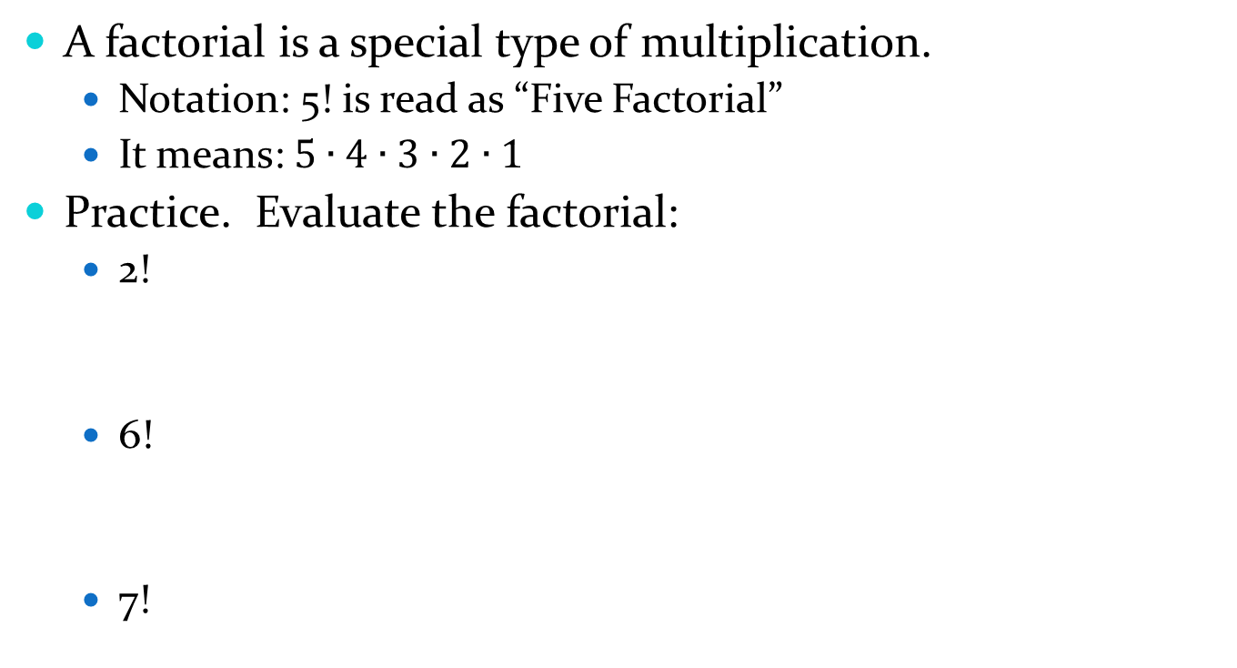
Factorials & Permutations
Note:
0! = 1
A factorial is a special type of multiplication.
  Notation: 5! is read as “Five Factorial”
  It means: $5∙4∙3∙2∙1$
Practice. Evaluate the factorial:
  2!
  6!
  7!

Slide 4
Permutations
Permutations find out how many ways you can arrange a number of objects.
  For example, if I wanted to know how many ways there are to select a first, second, and third place winner from this class, I would use a permutation to figure that out.
  Or, if I wanted to make a password out of the letters of my last name, WILTJER, I could use a permutation to tell me how many different passwords are possible.

Slide 5
Permutations
There is a formula for calculating the number of permutations an arrangement has.
The formula is:
Where n stands for the number of things you’re arranging
  and r stands for how many of the items you’re picking each time.

Slide 6
Example 1
How many different 4-letter passwords could you make from the letters of Miss Wiltjer’s last name?
7
How many letters can we choose from?
How many letters can we choose at a time?
4

Slide 7
Example 2
Alyssa is visiting Hawaii and plans to stay for 3 days. She wants to go to the beach, see Mauna Loa, and shop in Honolulu. How many ways can she arrange her schedule for the 3 days so that she does 1 activity each day?
How many activities can we choose from?
3
How many activities are we choosing altogether?
3
What’s the probability that if she randomly decides on a schedule , she will end up shopping, going to Mauna Loa, then to the beach?

Slide 8
Homework
Permutations & Factorials Practice worksheet

